Slide 1
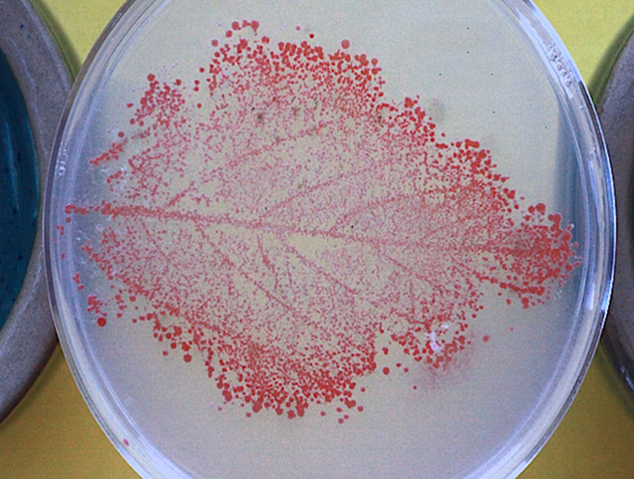


Kitty data: Methylotrophic Cultivation
Are my samples contaminated???
-Alix Knight

Slide 2
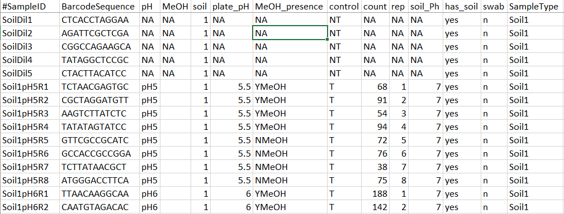
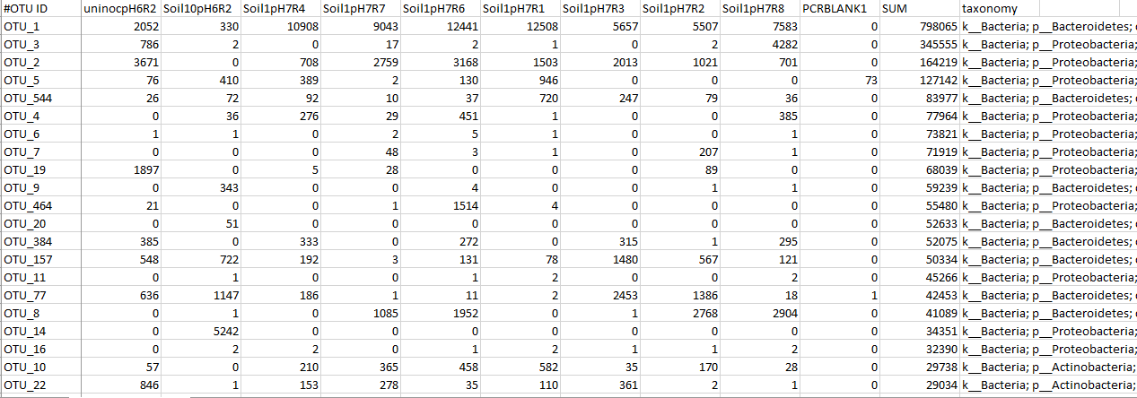
Soil type A
  Media pH5
    With methanol
    With methanol
    With methanol
    With methanol
    l
    With out methanol
    With out methanol
    With out methanol
    With out methanol
  Media pH6
    With methanol
    With methanol
    With methanol
    With methanol
    With out methanol
    With out methanol
    With out methanol
    With out methanol
  Media pH7
    With methanol
    With methanol
    With methanol
    With methanol
    With out methanol
    With out methanol
    With out methanol
    With out methanol
This is my data set, times 6 (five other soils + blank “soil”)
Mapping file
OTU Table

Slide 3
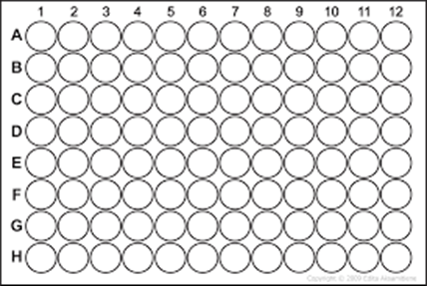
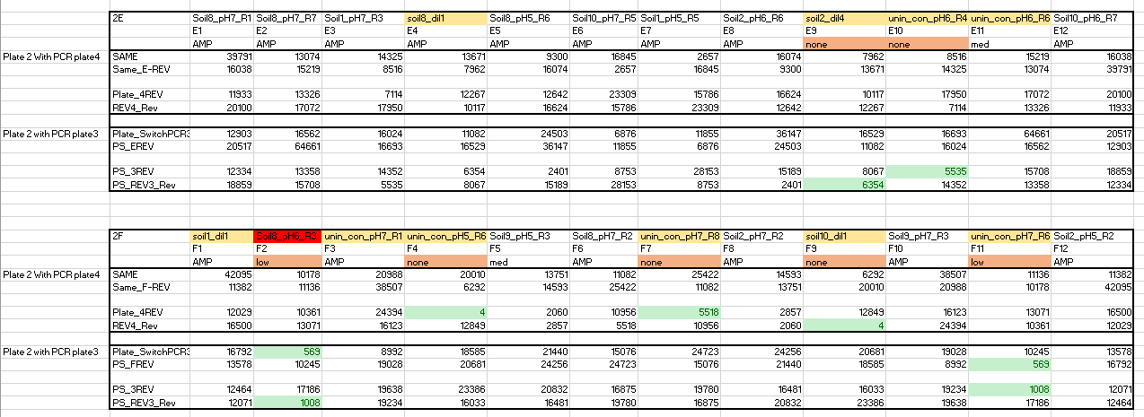
The first looks at my data revealed that many of the control/blank wells contained a lot of bacterial reads (10,000 or more even).
At this point, I need to figure out whether or not the blank wells have the same bacterial reads that occur in the actual experimental samples.

Slide 4

Analysis
I will then need to compare each soil type's associated OTUs to the blank samples' associated OTUs. But how?
The blanks could be seen as the control, while the soil samples are the observation.
Could create a counter: Counts the number of each specific OTU and compares it to the count of the OTU found in the "blank" type samples. Would then do an ANOVA of sorts to find the differences in counts.
Other statistical options?

Slide 5

Results?
Want I want to see is an analysis of the difference/similarities of OTU findings between the “real” samples and the “blank” samples.
I am not optimistic that I will find a significant difference.

